Slide 1


A PROJECT PRESENTATION ON “CROP PREDICTION FROM SOIL ANALYSIS USING MACHINE LEARNING”
By
CHETAN SANJAY DHUMNE Roll No: 1313
PANKAJ SURESH KAMBIRE Roll No: 1333
Under The Guidance of
Mr. AKSHAY TILEKAR
POST GRADUATE DIPLOMA IN BIG DATA ANALYTICS FEBUARY-2020
INSTITUTE FOR ADVANCED COMPUTING AND SOFTWARE DEVELOPMENT, AKURDI, PUNE

Slide 2
Introduction
India is the rich country having large number of natural and human resources and almost 70% economy of India is based upon agriculture sector.
Soil’s physical and chemical properties plays a dominant role to assess the soil quality and soil fertility.
The soil dataset is of 23 different districts and talukas of MAHARASHTRA state from which soil nutrients values like N, P, K, and other micro-nutrients are used to form a column of Crop on which the predictions are done.
Machine learning algorithms are useful to achieve the better accuracy in crop prediction and assessment.

Slide 3
Problem Statement
In this project we study and analyse the soil nutrition values using the ML classification technique and build the model for giving the best crop for productions.
Goals and Objectives:
1. To predict the best fitted Crop.
2. Soil quality analysis.

Slide 4
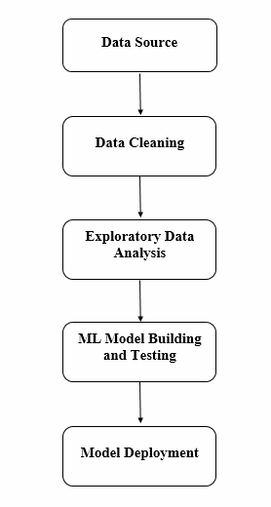
Block Diagram

Slide 5
Dataset Description
For This Project Data is collected From Soilhealth.dac.gov.in.
Weather conditions are Assumed for Kharif Season Crop Prediction.
Field | Description
sub_district_name_english1 | District Names
sub_district_name_english | Village Names
sample_no | Sample Number
farmername | Farmer Name
LandArea | Land Area in Hector
SurveyNo | Survey Number
Longitude | Longitude
Latitude | Latitude
pH | pH value of soil
EC | Electrical conductivity(Total Dissolve salts dSm/m )
OC | Organic Carbon (%)
N | Nitrogen (kg/hector)
P | Phosphorous (kg/hector)
K | Potassium (kg/hector)
S | Sulphur(PPM)
Zn | Zinc (PPM)
Fe | Iron (PPM)
Cu | Copper (PPM)
Mn | Manganese (PPM)
B | Boron (PPM)

Slide 6
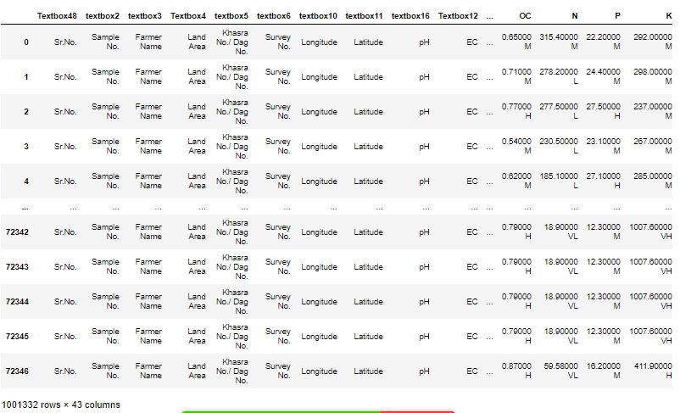
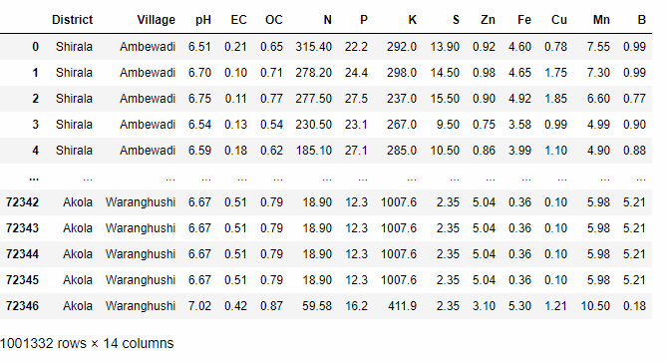
Data Cleaning and Pre-processing
Data cleaning refers to preparing data for analysis by removing or modifying data that is incomplete, irrelevant, duplicated, or improperly formatted.
The Data Contains 22 Duplicated Columns and 7 irrelevant Columns so dropped from Original Data
The Micro-Nutrient have Some Null Value we Replace those values with the Mean of column.
Data also contains misplaced decimal points in Micro-Nutrient columns like pH,EC,N,P,K converted into their accepted ranges.

Slide 7
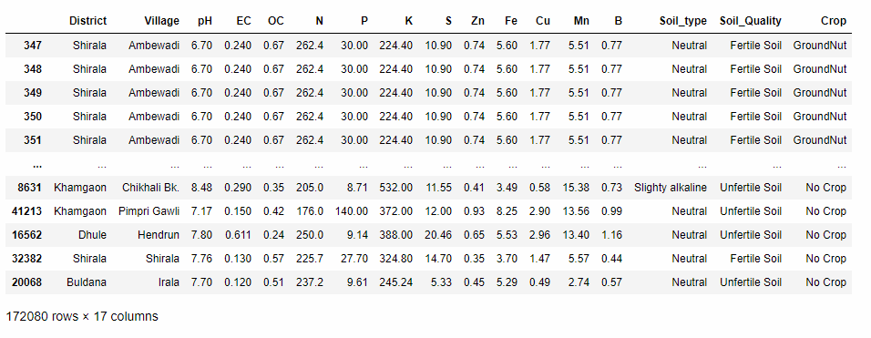
EDA & Feature Engineering
It is a way of visualizing, summarizing and interpreting the information that is hidden in rows and column format. ... Once EDA is complete and insights are drawn, its feature can be used for supervised and unsupervised machine learning modelling.
Crop, Soil_type and Soil_Quality columns are created after EDA and feature engineering.
Crop is target column.

Slide 8
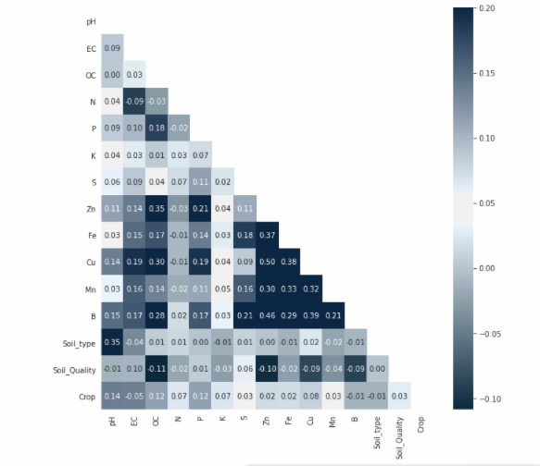
Correlation Heat map
This shows the positive correlation of target(Crop) variable with all other features columns.

Slide 9
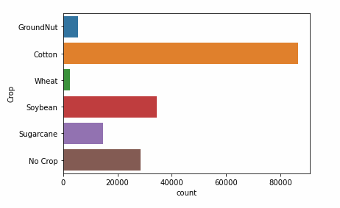
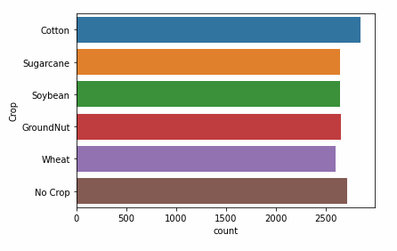
Under Sampling
To over the problem of unbalance data, under sampling technique is used.
In this the cotton crop has highest values which biased the data .
To balance all crops, random sampling is done by calculating the percentage of each crop.
1st graph shows unbalance data and 2nd shows balanced data.

Slide 10
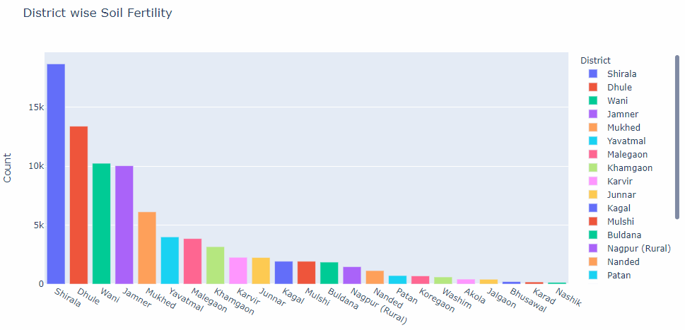
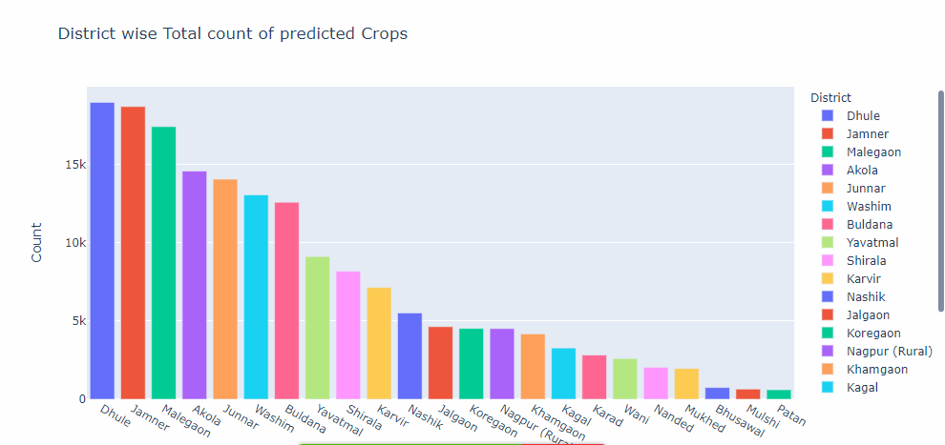
After analyzing the first graph it found that the Shirala, wani, Dhule districts’ framers are maintaining their soil very well on other side Nashik, karad, Bhusawal District framers are using excess fertilizers in their soil due to that soil Quality is not up to the Accepted range.
Other plot shows the district wise total count of predicted crops, Dhule has the highest count of crop prediction where as patan has lowest.

Slide 11
Model Building
Collecting data & analysing target variable
Data division into features and target columns
Encoding target column
Train & Test Splitting of dataset
Choosing ML model on basis of target variable. (Classification)
Train model on various classification techniques
Evolution of model
Hyper - Parameter tuning
Prediction on test dataset
This project Random forest is the Best classification Model amoung the Knn, Decision Tree,Xgboost Classifier.

Slide 12
Best Model Selection & Result
Model Name | Without Tuning Accuracy | With Tuning Accuracy
KNN Classifier | 62% | 73%
Decision Tree | 86% | 78%
Random Forest | 91% | 92.2%
SVM-OVO | 44% | 65%
SVM-OVR | 44% | 56%
XGBoost Classifier | 93.8% | 91.9%
Voting Classifier | 88% | 88%
Best Model is without hyper-tuning is XGBoost and with hyper-tuning is Random Forest.

Slide 13
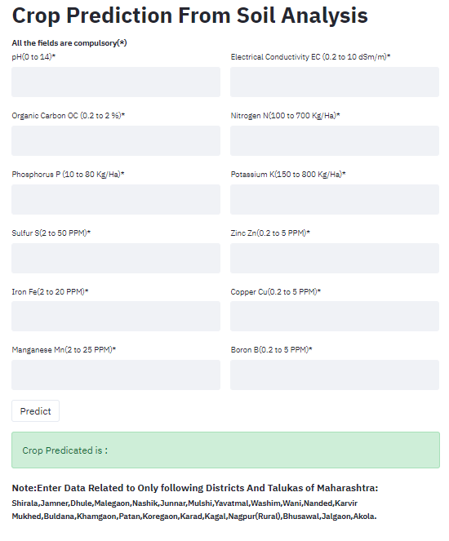
Model Deployment
For Deployment of Wed Application Stream-lit App Framework Use. Stream lit is opensource Framework for develop the web application for Data Science and Machine learning Models.

Slide 14
Advantage and Disadvantage
Advantage of this project:
Using this project we are aim to achieve the best potential of soil to achieve the good crops and minimum the use of fertilizer.
Disadvantages of previous technology:
Soil testing is done manually in labs and then analysed by scientists to predict the outcomes which takes lot of days to process. Sometimes the result be faulty because of human errors this all problems are solved by our project, it take very few time to predict results and gives accurate result.

Slide 15
Future Scope
For future work add parameters like moisture contain of soil, climate, locations, etc for crop prediction.
Increase the verities of crops and vegetables .
The various Crop Cultivation Seasons like Kharif/Rabbi and Rainfall for recommendation of Crop.
In Addition intercrop recommendation with primary Crop.
Recommendation Possible Plant disease if Soil Micro-Nutrient deficiency.

Slide 16
Conclusion
This project predicted the best fitted crop using Random Forest Classification Machine Learning model.
The Random Forest ML Model Accuracy is 92% with Hyperparameter tuning.
It will help farmers to take best decision on the basis of there soil nutrients.
It also helps to cut down the over use of fertilizers and its cost.
Additional benefits include; improved crop maturity and quality, higher tolerance to disease and pest damage, and increased growth.

Slide 17
THANK YOU

